Slide 1
Color Concepts
CSCI 4150/6050: Computer Vision
Slides Credit: Dr. Bryan Morse from BYU

Slide 2
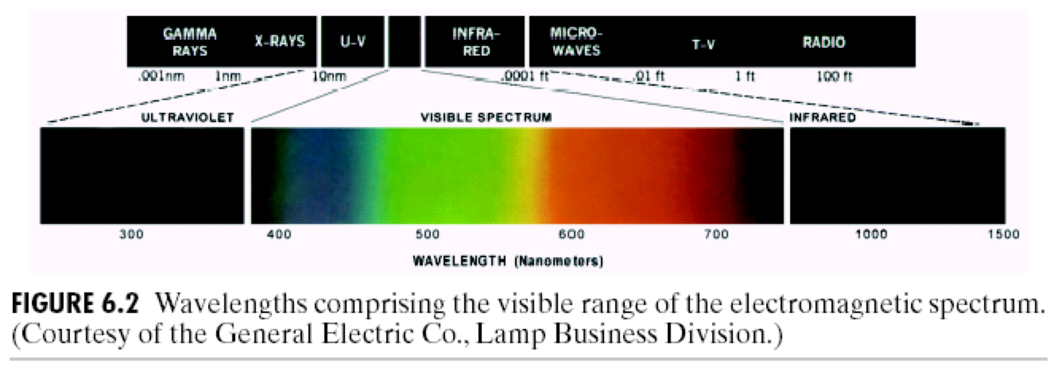
Light and Wavelengths
Visible light is in the range 400 nm (blue) to 700 nm (red)

Slide 3
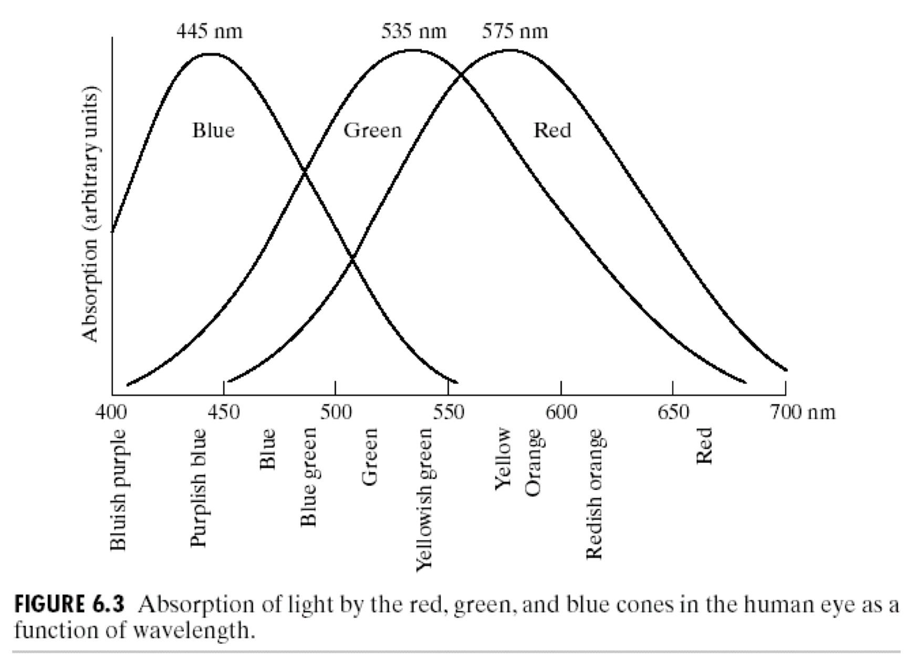
Perception of Light
Light is perceived according to different wavelengths, problem is the computer cannot do this, so we all turned to red blue and green, same as the cones of our eyes.
The eyes use the intersection of these 3 and interpretes the wavelength of the final color
Red and green are more closely related because as humans we need to be sensitive to them to look for food. The sky and water is blue so we don’t need that sensitivity
Cones have three different kinds of color-sensitive pigments, each responding to a different range of wavelengths
These are roughly “red”, “green”, and “blue” in their peak response but each responds to a wide range of wavelengths
The combination of the responses of these different receptors gives us our color perception
Multiple combinations of wavelengths can produce the same response
This is called the tristimulus model of color

Slide 4
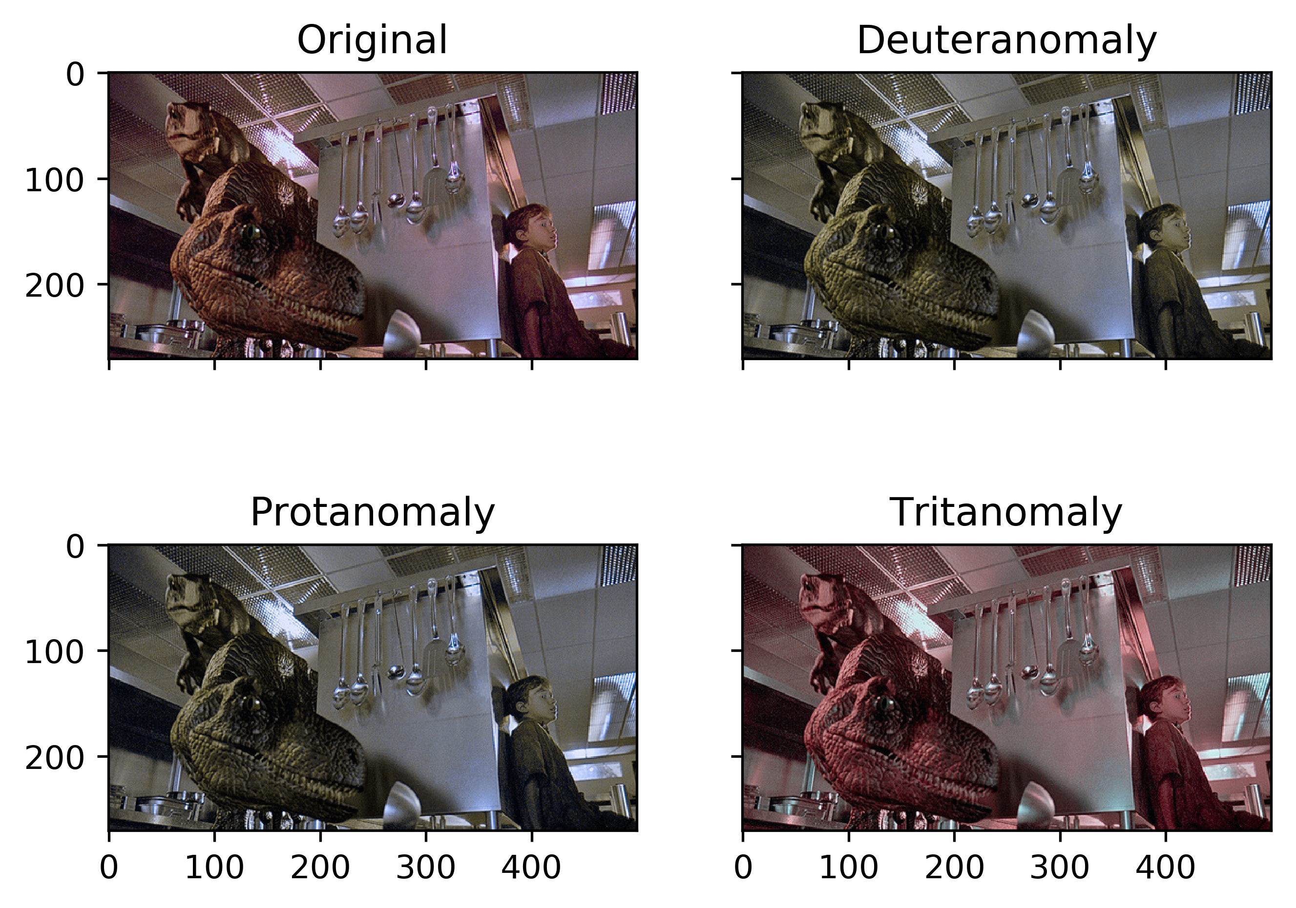
Aside: Colorblindness

Slide 5
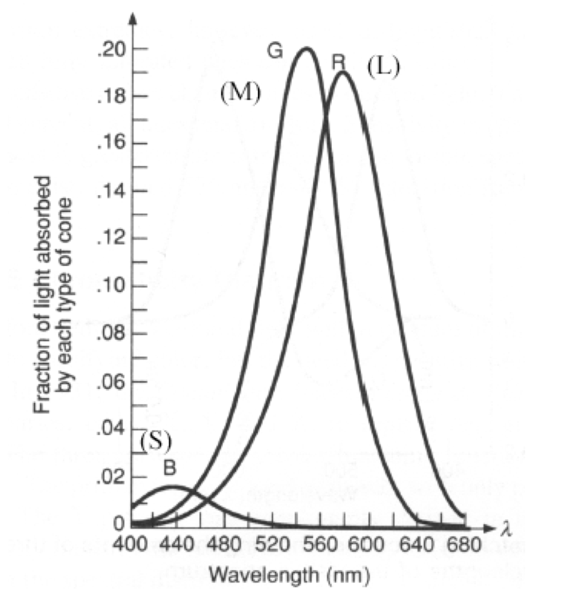
Perception of Light
The sensitivity and number of the three types of cones are different
More sensitive overall to green and red than to blue

Slide 6
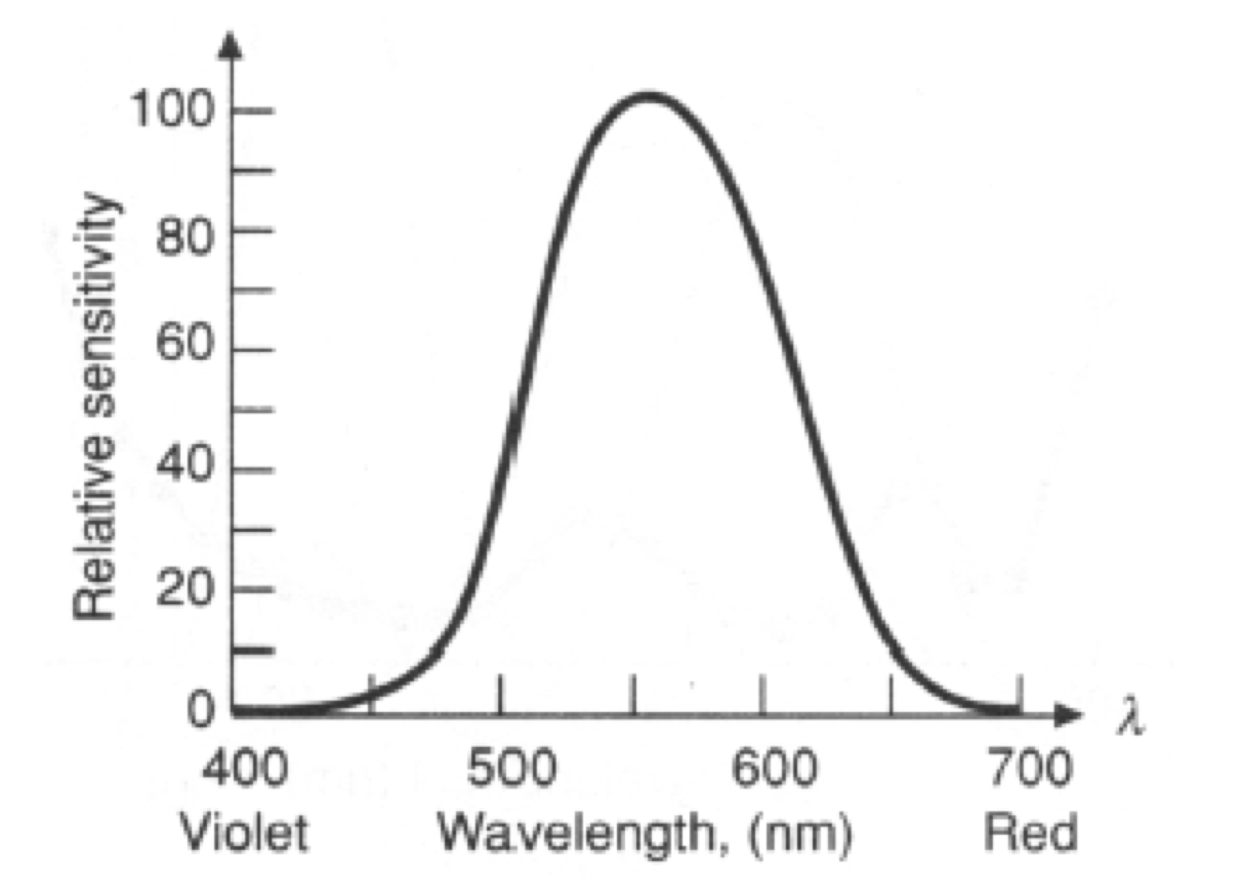
Intensity vs. Brightness
Technically, there is a difference between
  physical intensity
  perceptual brightness
Caused by differences in sensitivity of our eyes to different wavelengths

Slide 7
Turns out, we are really bad at telling brightness, even in grey scale!
https://www.cns.nyu.edu/~david/courses/perception/lecturenotes/brightness-contrast/brightness-contrast.html

Slide 8
Color Models
Color is a natural phenomenon, but for graphics and imaging we need to represent colors numerically
There are many ways to do this
Numerical representations of color are called color models

Slide 9
RGB Color Model
Disadvantage is it is not very clear how wwe can manipulate colors ie add brightness etc.
Simplest model is just to store red, green, and blue values
Colors can be thought of as points in a RGB cube

Slide 10
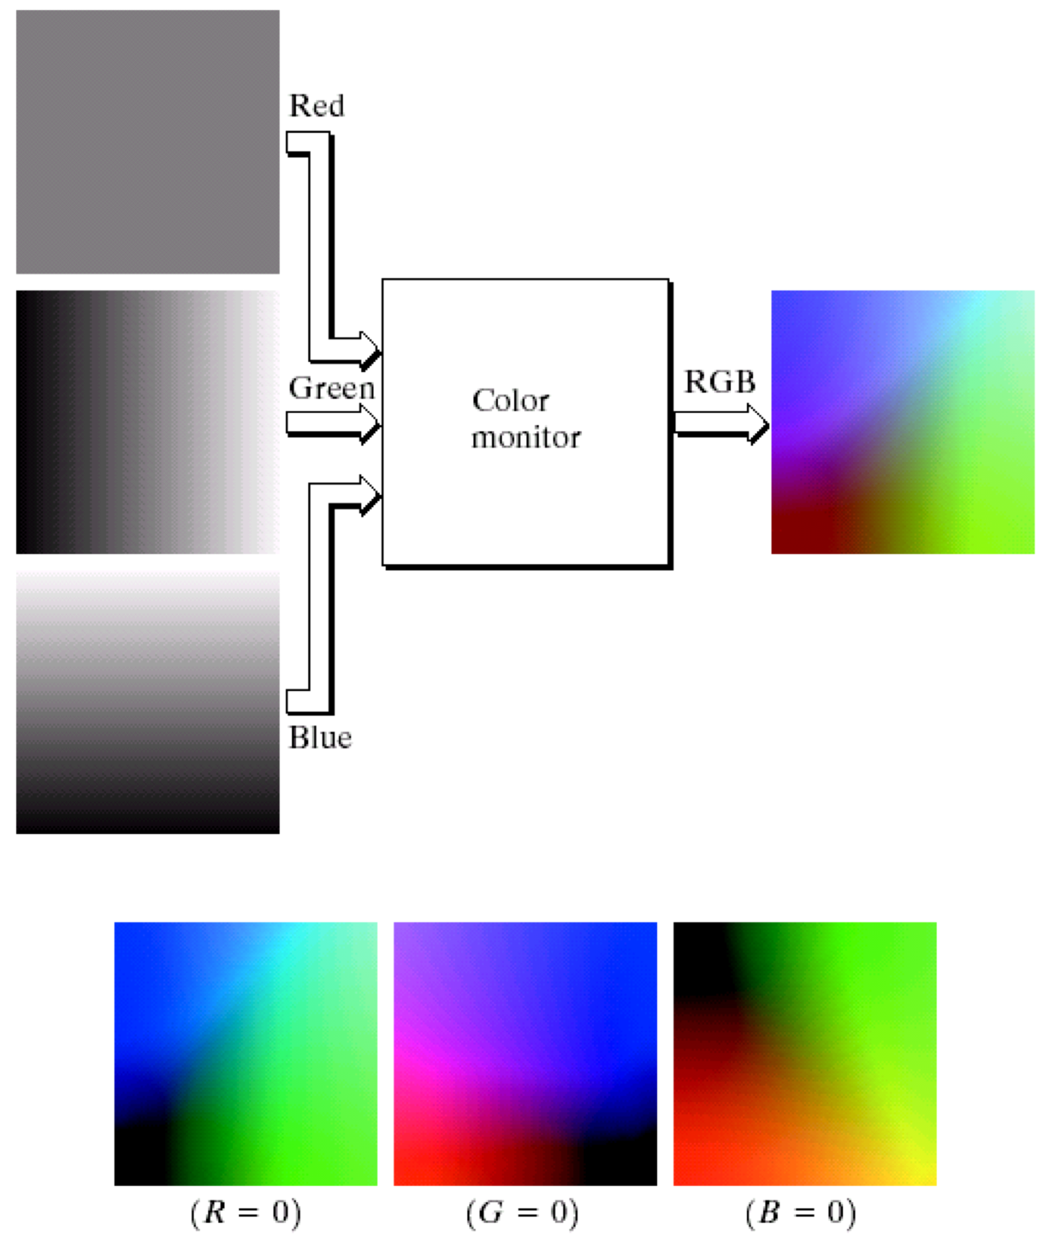
Color Channels
Can think of an RGB image as distinct color channels or color planes
Doesn’t matter how you store it:
  An RGB triplet for each pixel
  Three separate images

Slide 11
Primaries and Secondaries
Primary colors:
ones mixed to make other colors
Secondary colors:
pairwise combinations of primaries
Primaries and secondaries are complementary
Can be additive or subtractive

Slide 12
CMY Model
Subtractive media absorb light
  Real-world objects
  Paint
  Printing ink
The perceived color is what is
not absorbed
CMY uses subtractive primaries:
cyan, magenta, yellow

Slide 13
CMYK Model
It’s difficult and expensive to make pure subtractive primaries
Many systems introduce pure black as a fourth primary (K)

Slide 14
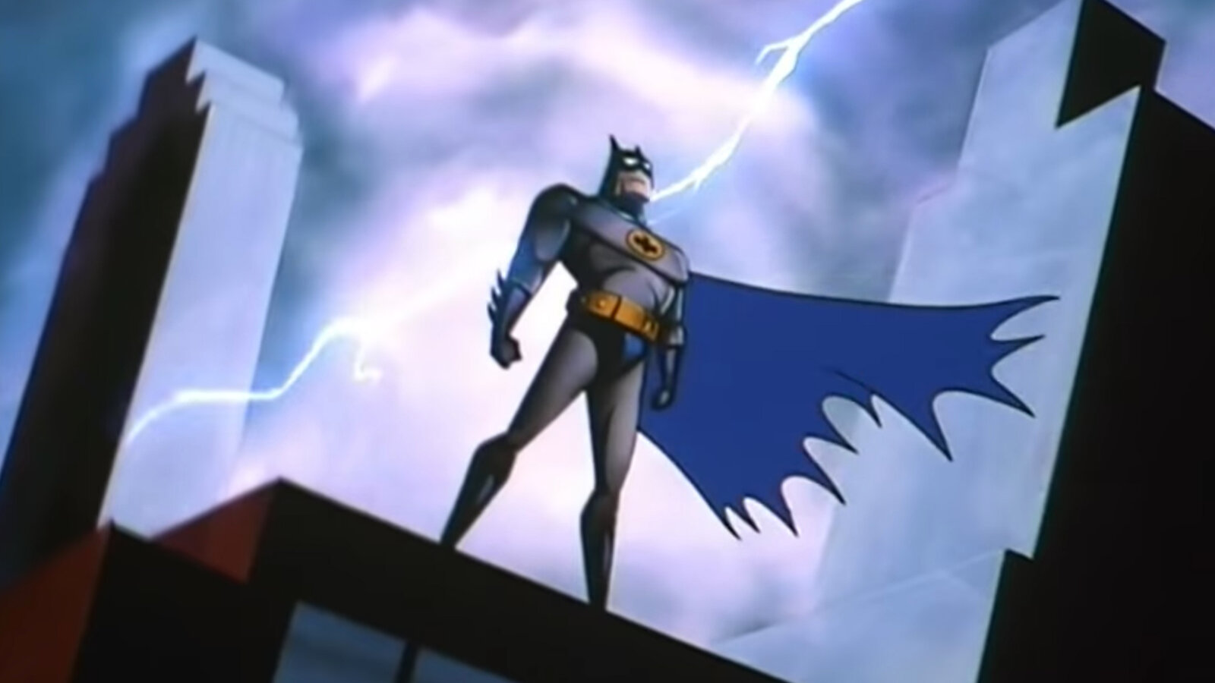
Aside: Batman Cartoon

Slide 15
Luminance and Chromaticity
RGB model is common but not all that intuitive to use
Artists tend to think more in terms of luminance separate from chromaticity
Much more intuitive:
  Luminance - how bright
  Hue - the “color” (wavelength)
  Saturation - how pure
(lots of variations on this idea)
Different brightnesses
Different hues

Slide 16
Hue
What we first think of as “color”
Pure wavelength of light
Artistically most important
Example:
red vs. green vs. blue

Slide 17
Saturation
If saturation is 0, we always have a gray scale because there is no color.
How pure a color is
A single pure color is 100% saturated
White, black, and gray are 0% saturated
Examples:
  red vs. pink
  strong vibrant colors - high saturation
  pastels - low saturation

Slide 18
Luminance
How bright /strong a color is
Equivalent to measuring quantity of light independent of wavelength
Most contributes to human perception of shape and form
Lots of synonyms
  Luminance
  Intensity
  Brightness (remember the difference)
  Lightness
  Luma
  Value

Slide 19
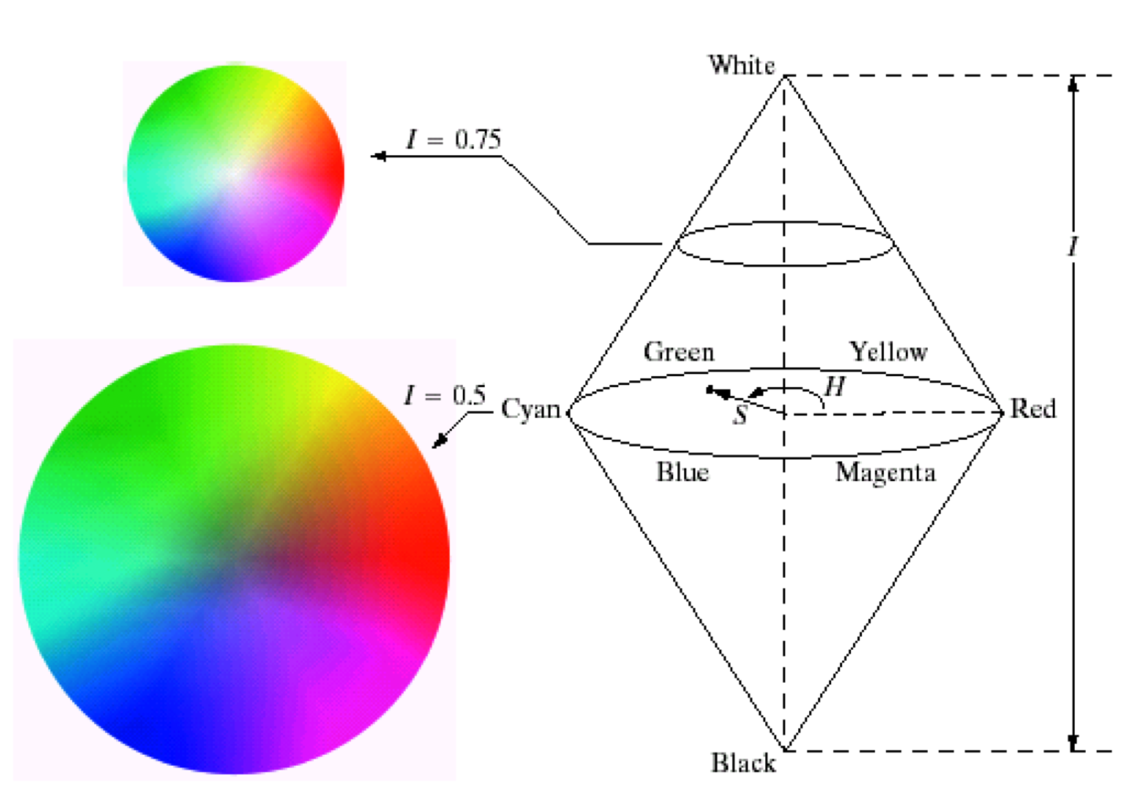
HSI Color Model
Hue saturation intensity model.
One axis is intensity (luminance)
The plane perpendicular to this axis represents chromaticity
  Angle = hue
  Distance from center = saturation
Can map this plane using a triangle, hexagon, or circle
The axis down the middle is the
“line of grays”

Slide 20
Variations
Summary: pick the color, how bright it si and how strong it is
Hue-Saturation-Value (HSV)
  Like HSI but with only one cone
Hue-Lightness-Saturation (HLS)
Hue-Value-Chroma (HVC)

Slide 21
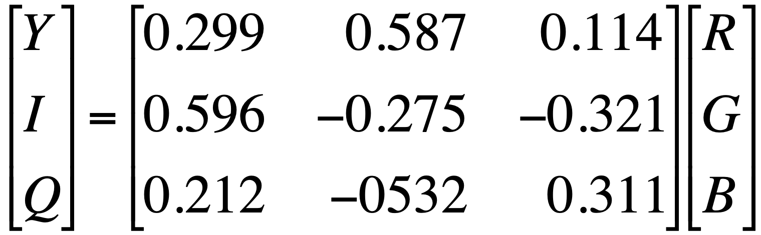
NTSC YIQ Model
YIQ Model used back in the days where black and whit tvs could clearly see using only the y channel. Those with colored channels added the I and Q channel and the matrix multiplication gave rgb.
This was used for broadcast to everyone in the past.
Chromaticity requires two parameters, but these don’t have to be hue and saturation
Lots of other variations
The NTSC model was used in analog broadcast television to have black and white TVs and color TVs work on the same signal
  Y = luminance
  I and Q = chromaticity

Slide 22
Other Chromaticity Representations
CIE LUV
CIE La*b* - attempts to be perceptually linear
YCrCb - used in the JPEG standard
Built for compression ie what colors can you compress the most without loosing data

Slide 23
Color Image Processing
Common approach:
  Convert from RGBto an appropriate model such as HSI, etc.
  Process
    Brightness/contrast adjustments
    Preserving or shifting the hues
    Adjusting the saturation
  Convert back to RGB if needed

Slide 24
Let’s try it in NumPy…
See time 1:19, on example soln in lab2, date aug 27th
We don’t have to convert all to a different color scale…..

Slide 25
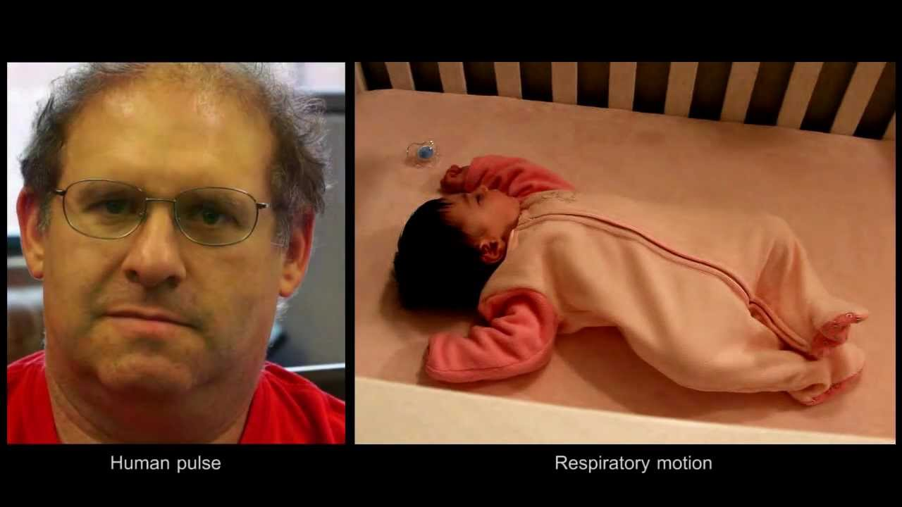
Cool Application:
Eulerian Magnification
https://www.youtube.com/watch?v=e9ASH8IBJ2U

Slide 26
Summary
Pick a color space that makes sense for your application:
  If the application is interactive, consider using HSI or other color space with explicit intensity/chromaticity
  If you want to process intensities but keep hues the same, work (or at least think) in that kind of color space
Keep physical limitations in mind.
There’s a lot more to color than RGB triplets!

Slide 27
One more thing to keep in mind…

Slide 28
Color Gamuts
There are colors our eyes can see that cannot be represented on the screen using rgb, because adding rgb do not give all the colors univerally availabel.
Can visualize the space of all visible colors using a chromaticity diagram
Important points:
  No three primaries can span the space of visible colors
  Different primaries will cover different parts of the space
  Colors produceable on one device may not be produceable on another
  Even if they can be reproduced, the mix of primaries might be different—requires calibration

Slide 29


Slide 31
Coming up...
Interimage: blending, masking, differencing, compositing
Neighborhood operations:
    noise reduction
    sharpening
    edge detection

